Slide 1
14. ArrayList and HashMap
[ECE20016/ITP20003] Java Programming
Notes:
‹#›

Slide 2
Agenda
Array-based Data Structures
Collection Framwork and HashMap

Slide 3
Class ArrayList
Consider limitations of Java arrays
Array length is not dynamically changeable
Possible to create a new, larger array and copy elements – but this is awkward, contrived
More elegant solution is use an instance of ArrayList
Length is changeable at run time

Slide 4
Class ArrayList
Drawbacks of using ArrayList
Less efficient than using an array
Can only store objects
Cannot store primitive types
Implementation
Actually does use arrays
Expands capacity in manner previously suggested

Slide 5
Class ArrayList
Class ArrayList is an implementation of an Abstract Data Type (ADT) called a list
Elements can be added
At end, at beginning, or in between items
Possible to edit, delete, access, and count entries in the list

Slide 6
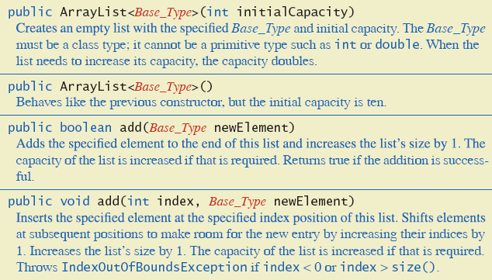
Class ArrayList
Methods of class ArrayList

Slide 7
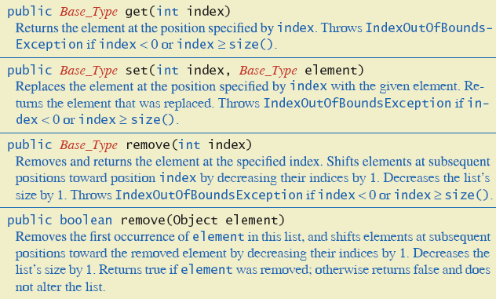
Class ArrayList
Methods of class ArrayList

Slide 8
Creating Instance of ArrayList
Necessary to import java.util.ArrayList
Create and name instance
Ex) ArrayList<String> list = new ArrayList<String>(); ArrayList<String> list2 = new ArrayList<String>(20); // you may set its length but it is not necessary.
This list will
Hold String objects
The second list Initially hold up to 20 elements. But its length is decided according to how many realy String instances are in the list.

Slide 9
Using Methods of ArrayList
Object of an ArrayList used like an array
But methods must be used
Not square bracket notation
Given
ArrayList<String> aList = new ArrayList<String>();
Assign a value with aList.add("Hi Mom"); aList.add(index, "Hi Mom"); aList.set(index, "Yo Dad");

Slide 10
Programming Example
A To-Do List
Maintains a list of everyday tasks
User enters as many as desired
Program displays the list
class ArrayListDemonstrator
https://github.com/lifove/ArrayListDemonstrator/blob/master/src/main/java/edu/handong/csee/java/example/ArrayListDemonstrator.java

Slide 11
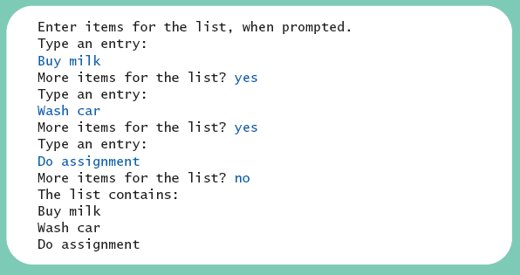
Programming Example
Result

Slide 12
Programming Example
class IntegerReader
https://github.com/lifove/ArrayListDemonstrator/blob/master/src/main/java/edu/handong/csee/java/example/IntegerReader.java
Result
Put integer numbers in one line (seperator is space):
12 43 23 56 76 12 67
The number of integer numbers from you: 7
12
43
23
56
76
12
67

Slide 13
Programming Example
When accessing all elements of an ArrayList object
Use a for-each loop
Ex) for(String s : toDoList)
System.out.println(s);
Use the trimToSize method to save memory
Trims the capacity of this ArrayList instance to be the list's current size.
To copy an ArrayList
Do not use just an assignment statement
Copies only the reference of the object
Use the clone method
Creates a deep copy
Example: https://github.com/lifove/ArrayListDemonstrator/blob/master/src/main/java/edu/handong/csee/java/example/DeepCopyTester.java

Slide 14
for-each Statement
Syntax
for( FormalParameter : Expression )
Statement
Expression must be Iterable or an array type
For more, see http://docs.oracle.com/javase/specs/jls/se7/html/jls-14.html#jls-14.14.2

Slide 15
Parameterized Classes, Generic Data Types
Possible to declare our own classes which use types as parameters
Ex) ArrayList<String> toDoList = new ArrayList<String>();
cf. Note earlier versions of Java had a type of ArrayList that was not parameterized

Slide 16
Agenda
Array-based Data Structures
Collection framework and HashMap

Slide 17
The Java Collections Framework
A collection of interfaces and classes that implement useful data structures and algorithms
The Collection interface specifies how objects can be added, removed, or accessed from a Collection
Brief introduction to HashMap
See other references for more info

Slide 18
HashMap Class
Used like a database to efficiently map from a key to an object
Uses the same <> notation as an ArrayList to specify the data type of both the key and object
Ex) HashMap<String, Integer> mountains =
new HashMap<String, Integer>();
class HashMapDemo

Slide 19
HashMapDemo
public void run()
{
HashMap<String, Integer> mountains = new HashMap<String, Integer>();
mountains.put("Everest",29029);
mountains.put("K2",28251);
mountains.put("Kangchenjunga",28169);
mountains.put("Denali",20335);
printMap(mountains);
System.out.println("Denali in the map: " + mountains.containsKey("Denali"));
System.out.println();
System.out.println("Changing height of Denali.");
mountains.put("Denali", 20320); // Overwrites old value for Denali
printMap(mountains);
System.out.println("Removing Kangchenjunga.");
mountains.remove("Kangchenjunga");
printMap(mountains);
}

Slide 20
HashMapDemo
public void printMap(HashMap<String, Integer> map)
{
System.out.println("Map contains:");
for (String keyMountainName : map.keySet())
{
Integer height = map.get(keyMountainName);
System.out.println(keyMountainName +
" --> " + height.intValue() + " feet.");
}
System.out.println();
}

Slide 21
Programming Example
SalesReporter using HashMap instead of SalesAssociate class

